Slide 1
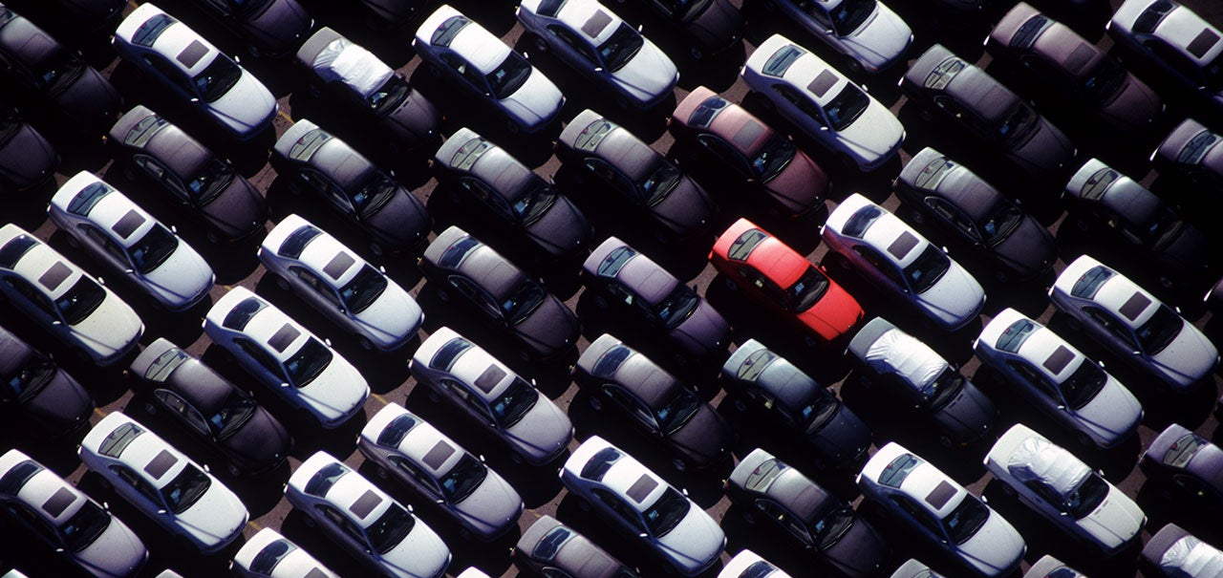
Car Price Predictor App
Alec Henderson, Andrew Paton, Vilma Diaz, Celena Blackwood, Dan Tinarwo

Slide 2
Dan
01
Executive Summary
02
Data Sourcing
Project 4
Presentation
03
Price Prediction Modeling
04
Web App
05
Conclusions

Slide 3
Dan
Executive Summary
The purpose of the app is to predict a vehicles price based on its attributes and mileage. In this project we split our data set into three main categories (Sedans, SUVs, Pickups). In this presentation we will discuss our source data, model selection, and app implementation.
Data Sourcing
Model Selection
App development
Our source data contains over 5.7 million vehicle sales records in the state of Illinois over a two-year period (2018-2020).
We attempted to use multiple models for our price prediction. First, we choose to use a clustering model that did not work well with non-discrete variables. We then used a Random Forest Regression model that was able to more accurately predict price.
We used Java Script and Flask to develop our app. We then chose to host our app using Heroku.

Slide 4
Andrew
Data sourcing
Explanation of Data Sourcing and Cleaning Process
Data gathering
Chunk CSV
Vehicle filtering
Concatenate csv
We downloaded our data from Kaggle in a single CSV file. The file is 5.23 GB and therefore to large to open or load directly into pandas.
We used the chunk csv function in python to split the larger file into 12 smaller files.
Once we had 12 smaller files, we filtered the files to only include three categories of vehicles (Sedans, SUVs, Pickups).
Once we removed outliers and filtered on vehicle type, we concatenated the 12 csv files back into as single csv file.
01
02
03
04

Slide 5
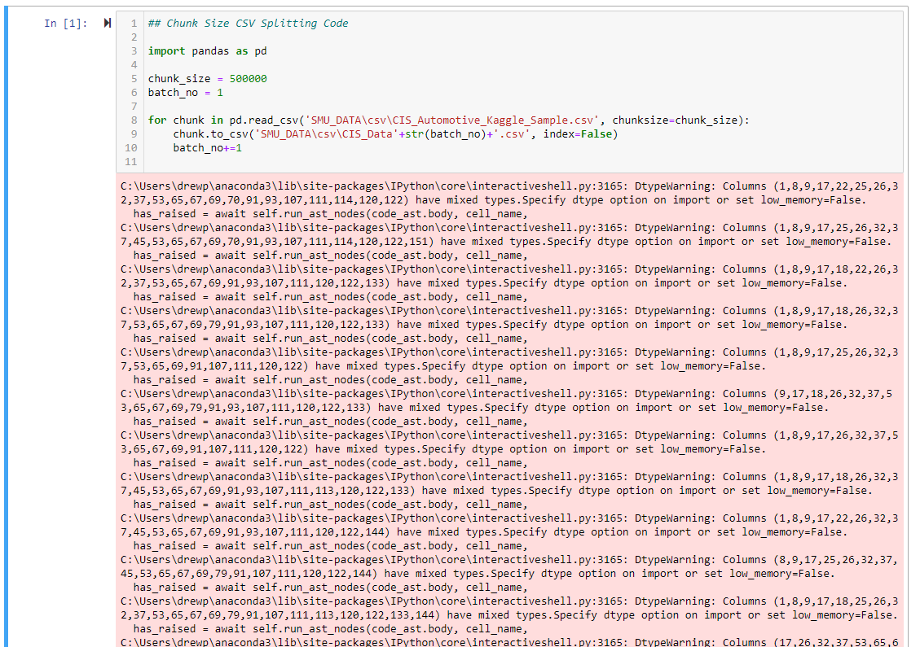
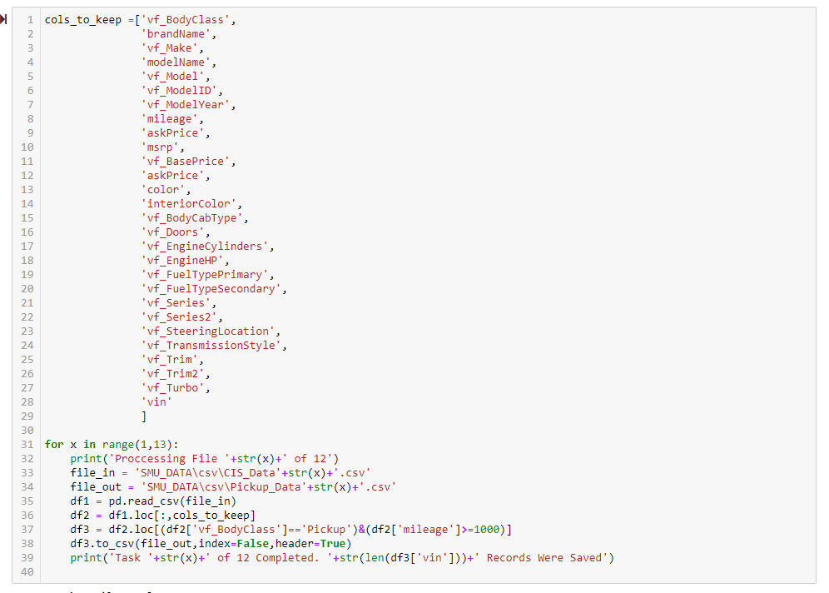
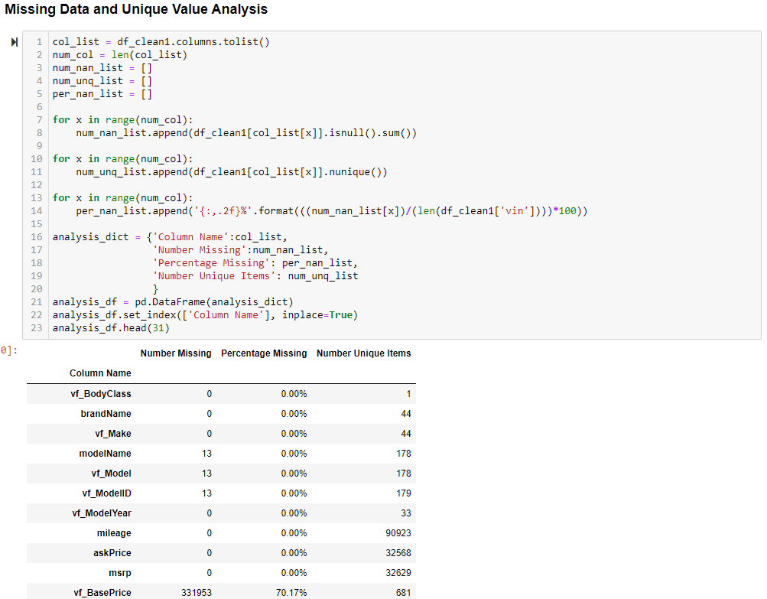
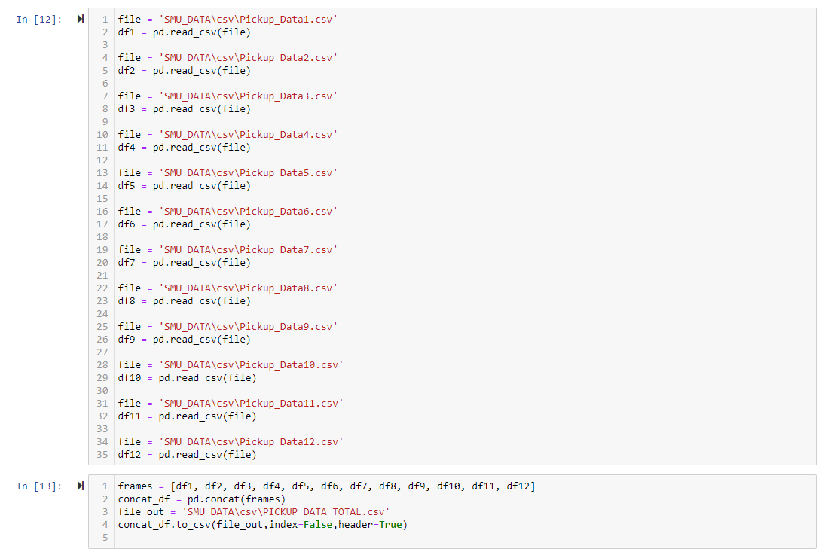
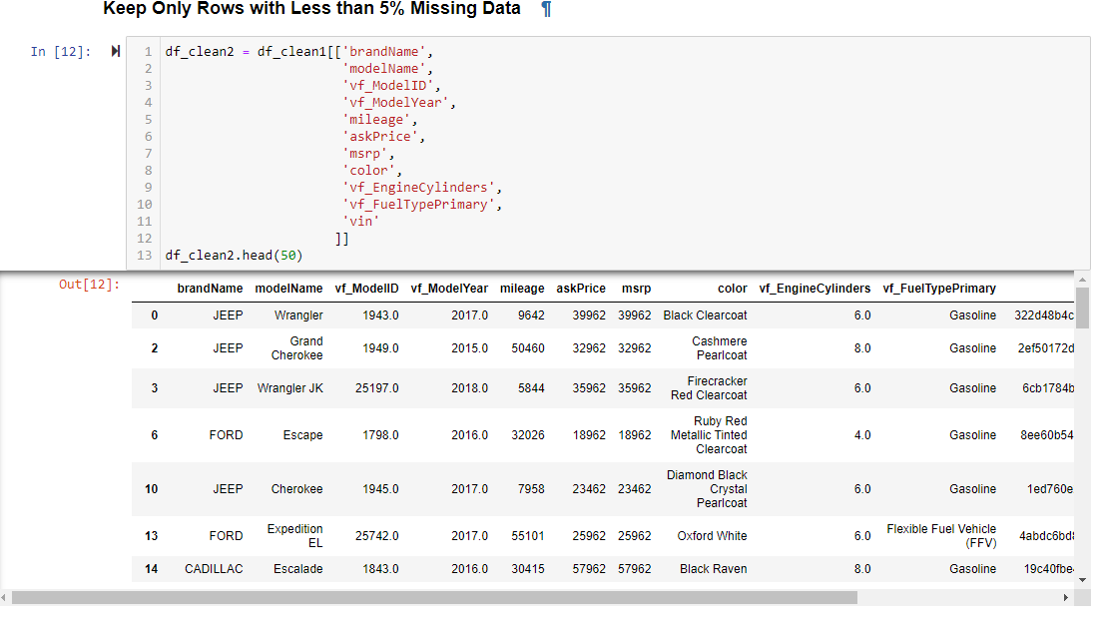
Andrew
Data Sourcing Code
Chunk CSV
Vehicle filter & concat
Data cleaning

Slide 6
alec
Model selection
Machine Learning Algorithms Used
Knn & k-means
Random forest regressor
Pros:
Clustering showed our data had clear segmentation by vehicle type.
Helped suggest splitting our data to have a more accurate prediction model.
Cons:
Did not deal well with non-discrete data predictions.
Had a very low accuracy.
Pros:
Segmentation of data showed an improvement in price prediction accuracy.
Works well with non-discrete data predictions.
Cons:
Not able to easily visualize multi-feature regressions.

Slide 7
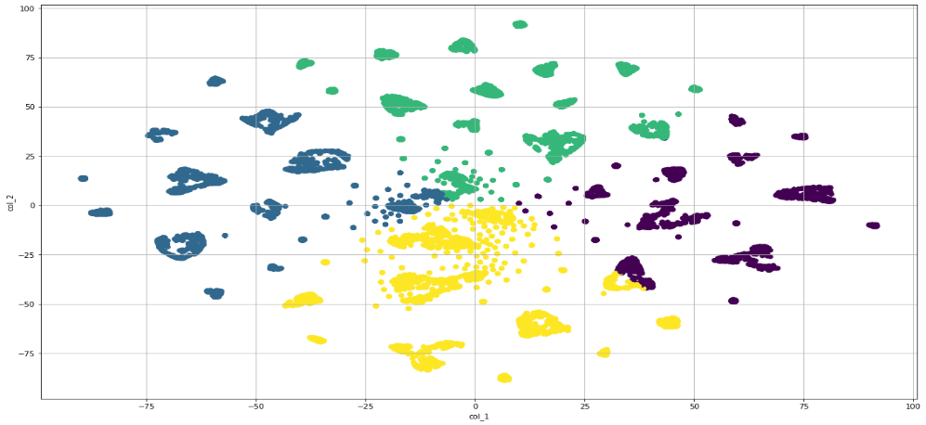
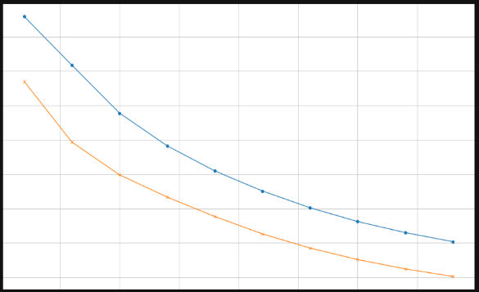
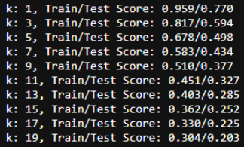
alec
clustering models
KNN and K-Means Challenges

Slide 8
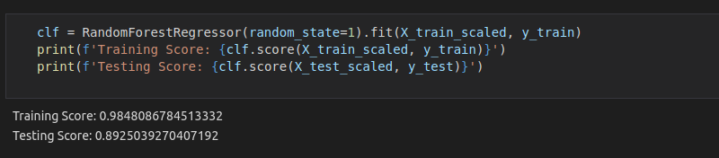
Dan
regression models
Random Forest Regression Model
Model explanation
We used a Random Forest Regressor because it was able to predict continuous values (non-discrete) values. We chose to use a Random Forest Regression model over a Linear or Polynomial Regression model as it deals better with “unknown” non-linear predictions. When using a Polynomial Regression model, we would have to specify the correct number of curves (powers) for the model. When this is unknown, using a Random Forest Regression model finds the most accurate curve fitting regression model.

Slide 9
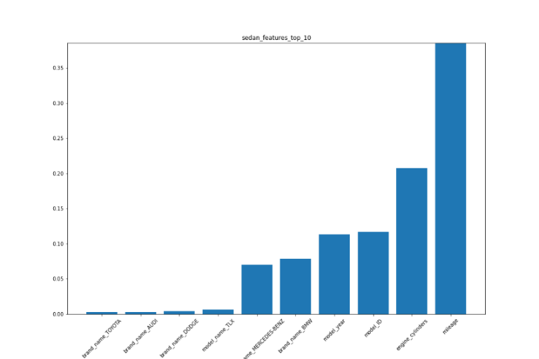
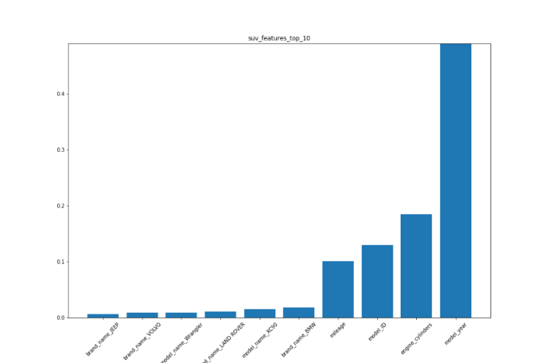
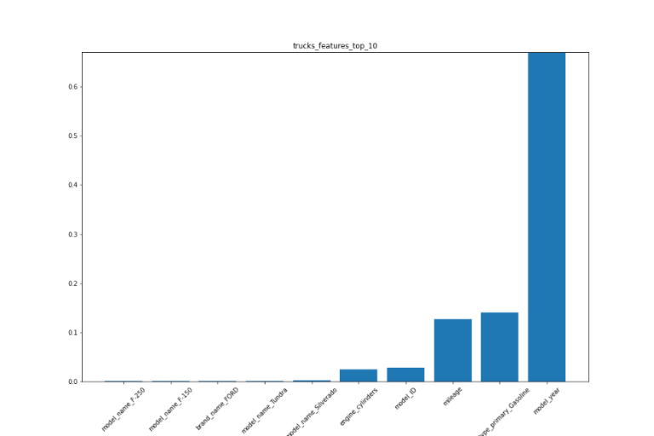
vilma
feature weighting
Sedan
suv
pickup
Vehicle makes
Top 5 features
Vehicle makes
Top 5 features
Vehicle makes
Top 5 features
Toyota
Audi
Dodge
TLX
Mercedes-Benz
BWM
Etc.
Cylinders
ID
Mileage
Gasoline
Year
Jeep
Volvo
Wrangler
Land Rover
XC90
BMW
Etc.
Cylinders
ID
Mileage
Gasoline
Year
Ford F-150
Toyota Tundra
Chevy Silverado
Etc.
Cylinders
ID
Mileage
Gasoline
Year

Slide 10
celena
Full Stack app process
Process Flow of Hosting Our Model as a Full Stack App
HTML & JS Template
Flask app
Ui Connection
tableau
Heroku
We started with a HTML & Java Script template that we modified to suit our user interface requirements.
We created multiple routes to host our three models based on vehicle type (SUV, Sedan, Pickup). We also included a homepage.
We then connected our user interface to our models. This was to allow our users to manipulate our models from the app.
We developed tables and charts in Tableau. Once completed we took the HTML and applied it into our app.
We took our Flask App, HTML & JS code, as well as our Tableau visuals and hosted on Heroku to finalize our app project.

Slide 11
alec
methodology
conclusion
questions
and
conclusions
We began our project to solve a simple question, “Can you accurately predict car pricing based on attributes?”. In the current market environment with supply chain challenges, we have all been affected by inflated pricing which pushed to find a reason behind the pricing. In order to do so we used historical car sales data that required us to clean then filter based on vehicle type. Our initial misstep using cluster models proved the need to split the data based on vehicle type. We then used a Random Forests Regression model to better predict non-discrete price data. With our models complete we used HTML and Java Script to build our webpage. With Tableau we created charts to host on our webpage. We used Flask to host our models and make them interactive. Finally, we hosted the app on Heroku.
With the challenge of accurately predicting car pricing based on attributes, we found that using a Random Forest Regression model allowed us to accurately (89%) predicted the sale price of the used car. One of our key findings was that by splitting the data by vehicle type and running separate regression models significantly improved the accuracy of our model.
Building a full stack app to host the model allows a user to quickly modify and view the project in an easy-to-use visual form.

